Slide 1
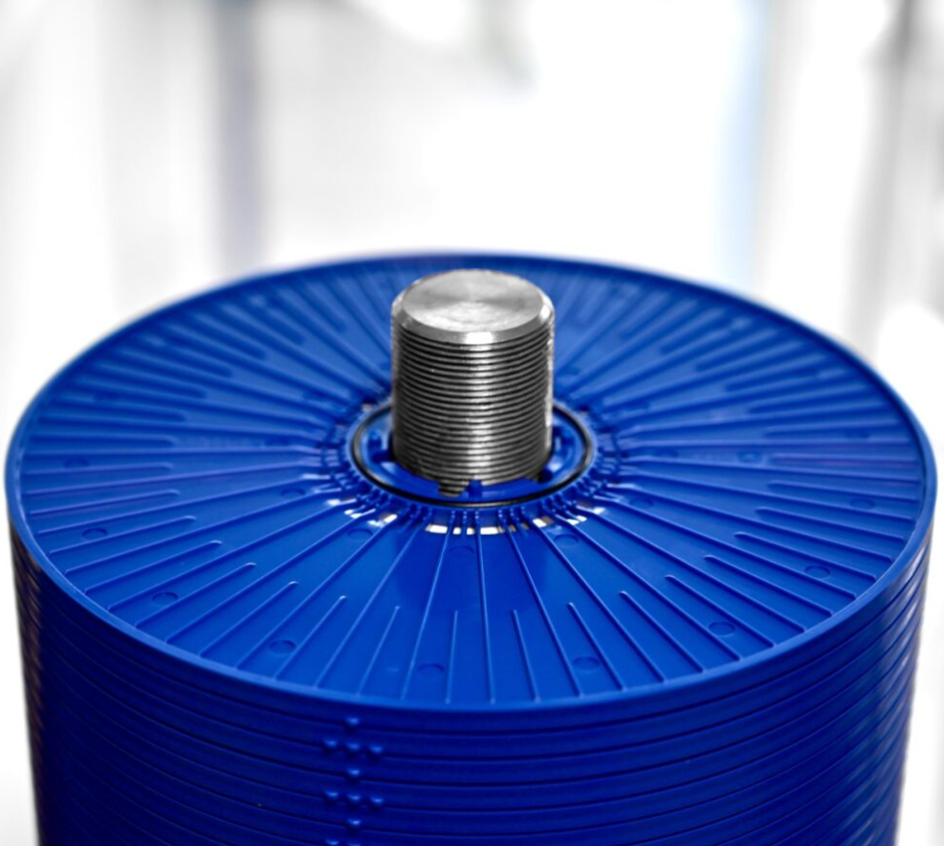
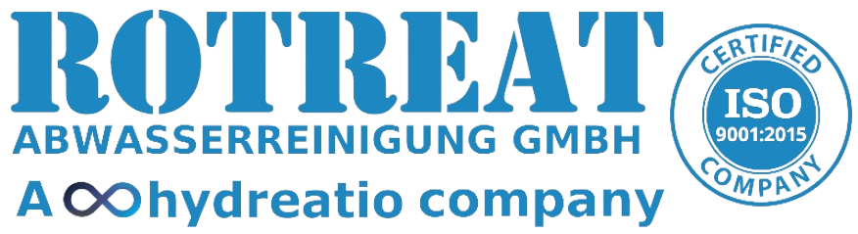
Membrane-based wastewater treatment for waste management plants
Leachate treatment using Reverse Osmosis (RO)
Liquid waste treatment using Membrane Bio Reactor (MBR)
Notes:
honour for me to present you today our experiences in membrane-based wastewater treatment for waste management plants

Slide 2

Agenda
Introduction
Membrane filtration overview
Reverse Osmosis – a short introduction
  RCDT Technology
    Radial Channel Disc Tube Module (RCDT)
    EASY CLICK MODULE
Membrane Bio-reactors (MBR) for wastewater treatment
  MBR – a short introduction
  MBR applications:
    liquid waste treatment
    contaminated surface water treatment
    Soft drink production

Slide 3
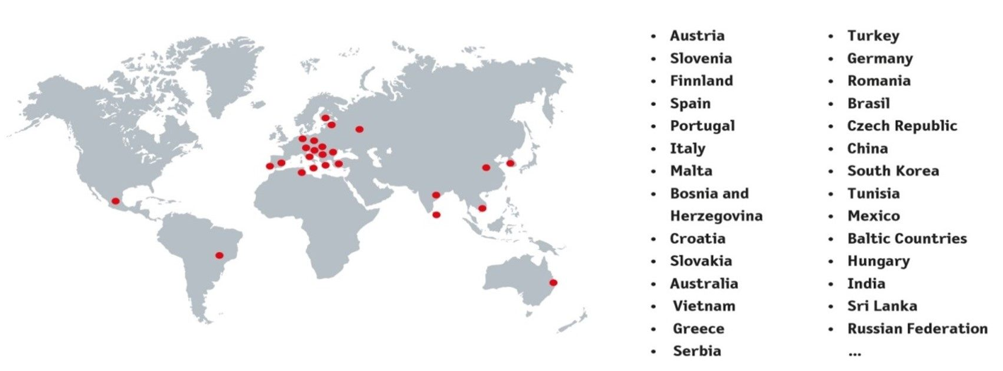
General Information
ROTREAT Abwasserreinigung GmbH a Hydreatio company was founded in 1993 and concentrates on
developing and producing membrane filtration plants.
Beside the plant technology the patented RCDT (Radial-Channel-Disc-Tube) module system has been invented as
an economic and efficient reverse osmosis device for the treatment of waste-, salt- and brackish water.
Moreover, ROTREAT offers MBR (membrane bioreactor) for a wide variety of industrial wastewater and
contaminated surface water.
Introduction | I
The areas of application of the systems are international and currently successfully cleaning following wastewater quantities:
Leachate water 12.000 m³/d
Industrial wastewater 15.800 m³/d
Rotreat prevent a needed capacity of public wastewater treatment for 2,8 Mio. habitant

Slide 4
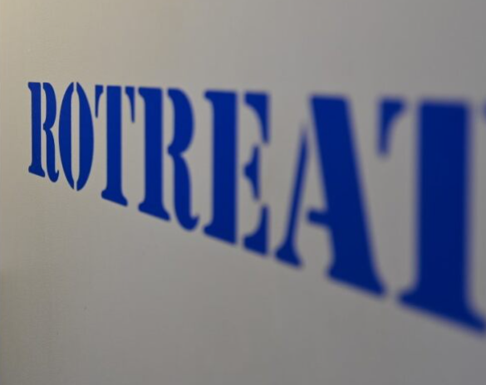
Milestones
1993: Exclusive representation of DT products in Austria
1999: Market leader Austria, 16 landfill leachate systems
2001: RCDT 1.0 disc, 65bar + 120bar module, 7.6m² membrane area
2001: Construction & operation of 1st MBR plant for municipal wastewater in Austria
2006: RCDT 1.0 XL with 9.6m² membrane area/module
2007: 90 bar operating pressure for all RCDT modules
2008: "Easy Click" system for membrane replacement
2011: RCDT 1.0 XXL with 12m² membrane area/module
2015: RCDT 2.0 disc and round membrane weld
2016: Cooperation with Mitsubishi for hollow fiber modules used in MBR
2018: 25th anniversary
2022: RCDT 3.0 with up to 13m² membrane area/module
2023: 30th anniversary & merge with Hydreatio Group
2023: Development of ecofriendly membrane cleaners with Ravago
Introduction | I

Slide 5
Conventional versus membrane water treatment
Conventional chemical/physical water treatment
Coagulation
Flocculation
Sedimentation
Sand filtration
Disinfection
Raw water
Drinking Water
Process water
Membrane technology
Membrane technology replaces 3 steps of conventional water treatment
Pre treatment
Disinfection
Raw water
Drinking water
Process water
Water treatment with Membranes

Slide 6
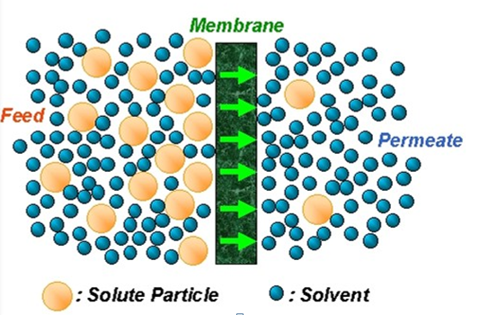
Membranes Processes
A membrane is a selective barrier that permits the separation of certain species in a fluid by combination of sieving and diffusion mechanisms
Membranes can separate particles and molecules and over a wide particle size range and molecular weights

Slide 7
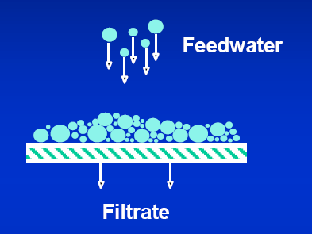
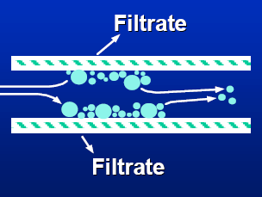
Filtration Modes
Dead-end flow mode:
Perpendicular flow to the membrane
Complete flow through the membrane
Faster material buildup on membrane surface
Cross flow mode:
Perpendicular flow to the membrane
Feed flow spread into filtrate and retentate
Slower material buildup on membrane surface

Slide 8
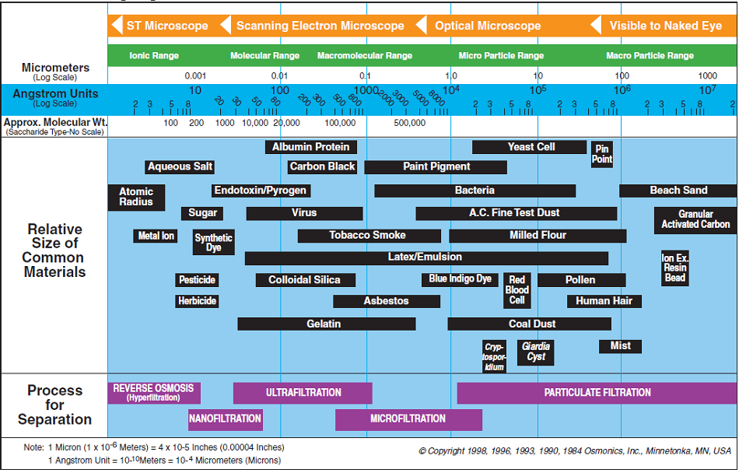
Filtration Spectrum

Slide 9
Membranes Classification
- By particles size range and molecular weight
Membrane Pore Size (μm)
Pressure
(bar)
Reverse Osmosis
(RO)
30-60
10⁻⁴-10⁻³
Suspended solids
Bacteria
Viruses
Multivalent ions
Monovalent ions
Water
Nanofiltration
(NF)
20-40
10⁻³-10⁻²
Ultrafiltration
(UF)
1-10
10⁻²-10⁻¹
Microfiltration
(MF)
< 1
10⁻¹-10 ¹

Slide 10
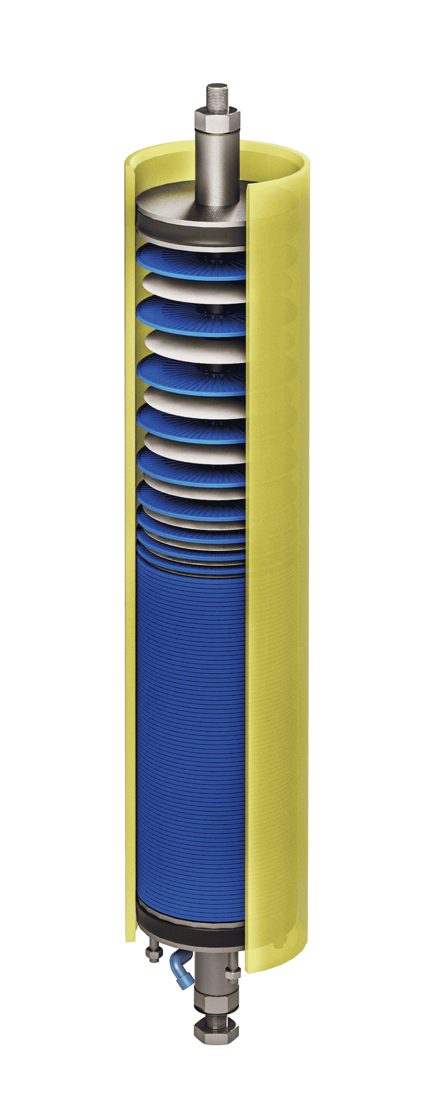
Advantages of RCDT systems
Constructed for continuous operation
Designed to desalt and purify
  Sea Water
  Leachate
  Industrial wastewater
Highest effluent quality
State of the art membrane technology
Fail-safe unattended operation
Compact and flexible modular units
Low-cost maintenance, operation and service
Reverse Osmosis – Membrane Technology | III

Slide 11
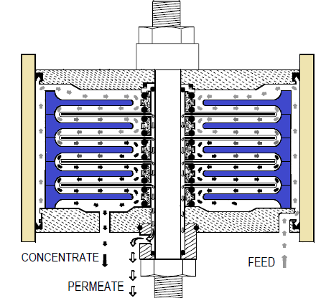
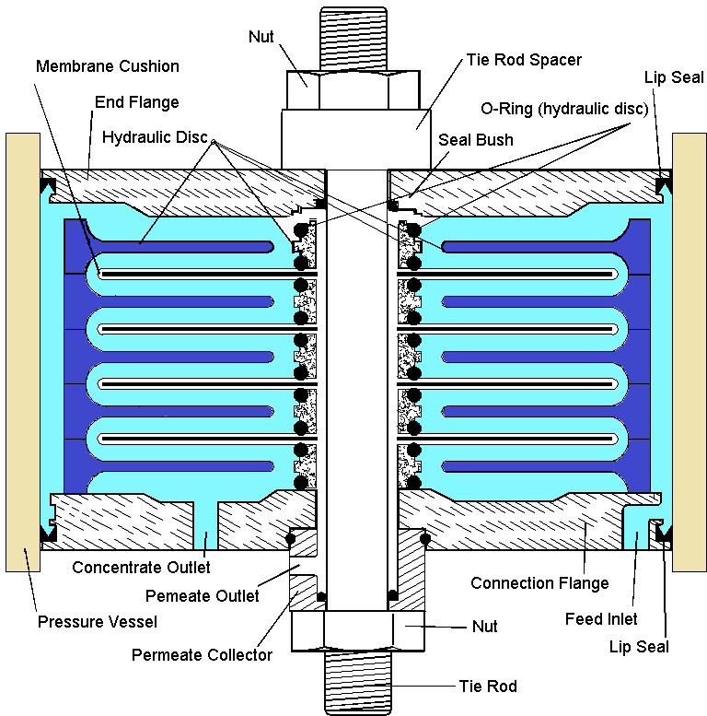
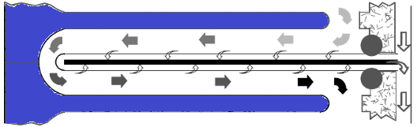
Reverse Osmosis Module
RCDT Flow

Slide 12
Use Case: RO for landfill leachate
CASE (Year): | RO for landfill leachate (2020)
Advantages / Specialties | Reliable, safe operation, stable pure water quality Easy handling of RO systems in the event of (shorter/longer) shutdowns Space-saving: plant space requirement approx. 50% compared to conventional systems Excellent effluent quality, water can be reused immediately Effective: 98-99% of all (in)organic substances dissolved in water can be rejected Permeate purified to such an extent that it can be fed directly into a receiving water Lower operational costs: Energy consumption reduced by up to 30% Easy maintenance through easy-click system (reduced labor costs and plant off-time) Service life of RO systems > 10 years
REFERENCES for RO – Leachate water | III

Slide 13
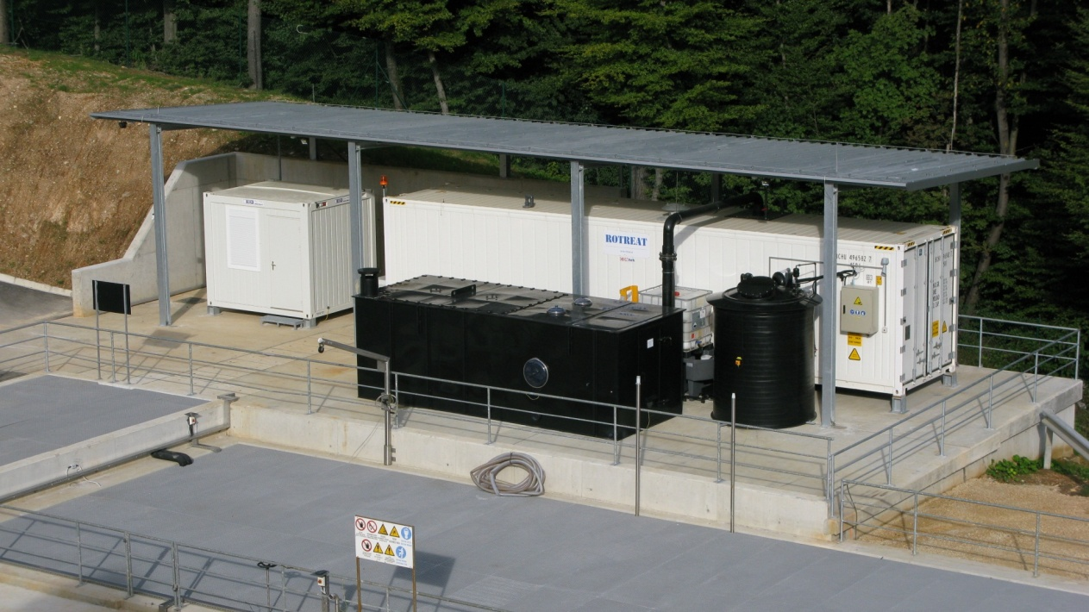
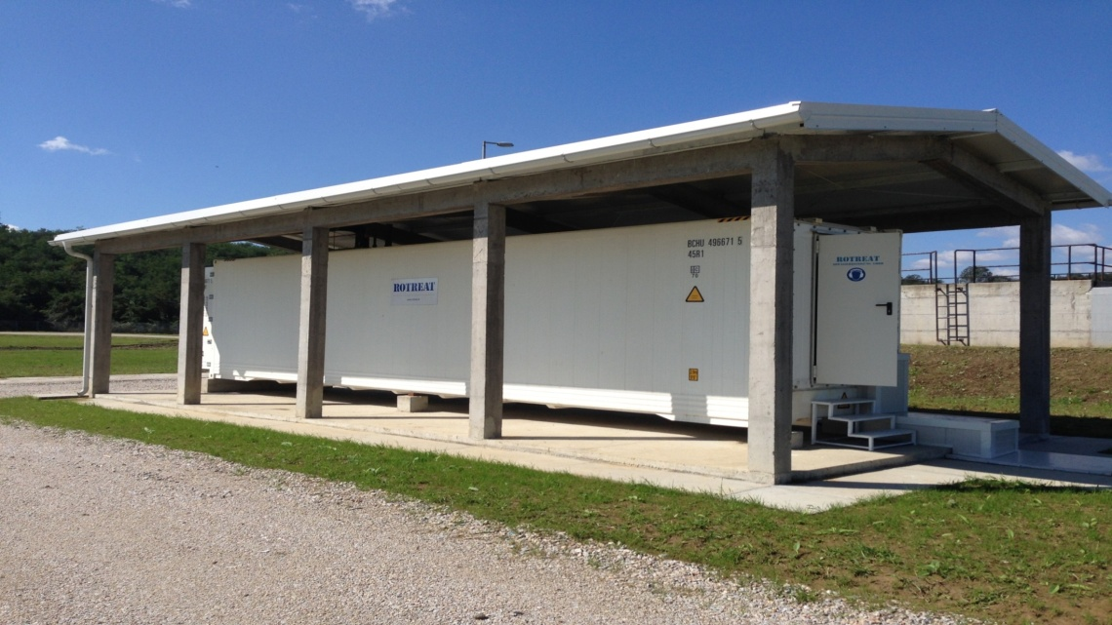
RCDT references
Novo Mesto, Slovenia
120 m³/d leachate treatment
Double stage RO, 34 + 9 RCDT modules
408 m² + 108 m² membrane area
Bijeljina, Bosnia / Herzegovina
35 m³/d leachate treatment
Double stage RO, 13 + 3 RCDT modules
156 m²+ 36 m² membrane area
REFERENCES for RO – Leachate water | III

Slide 14
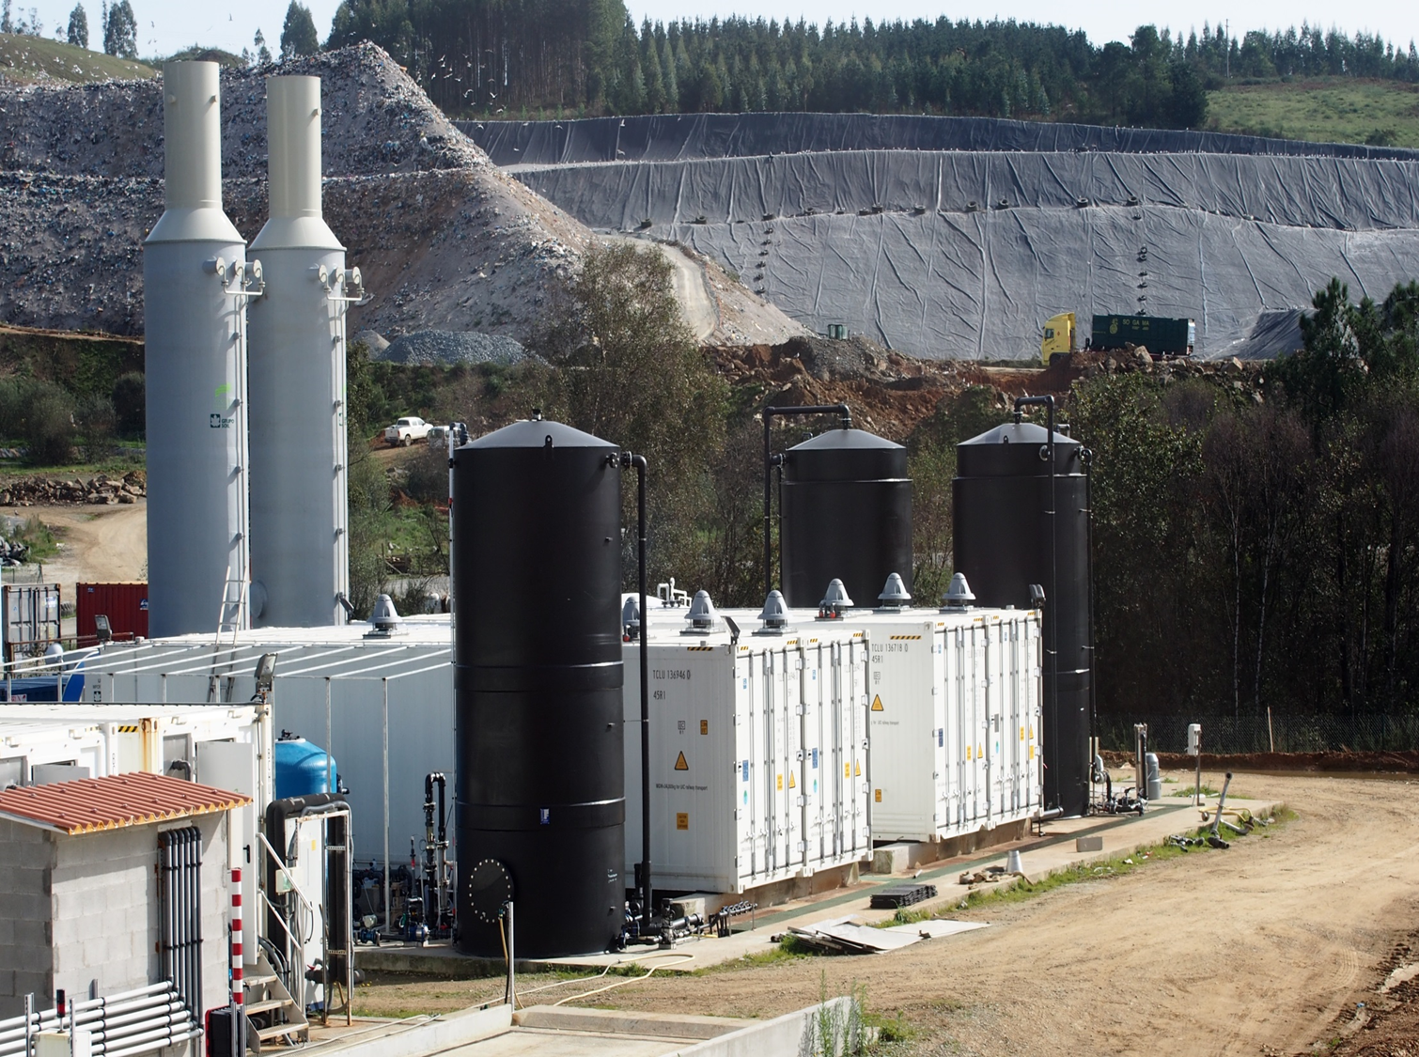
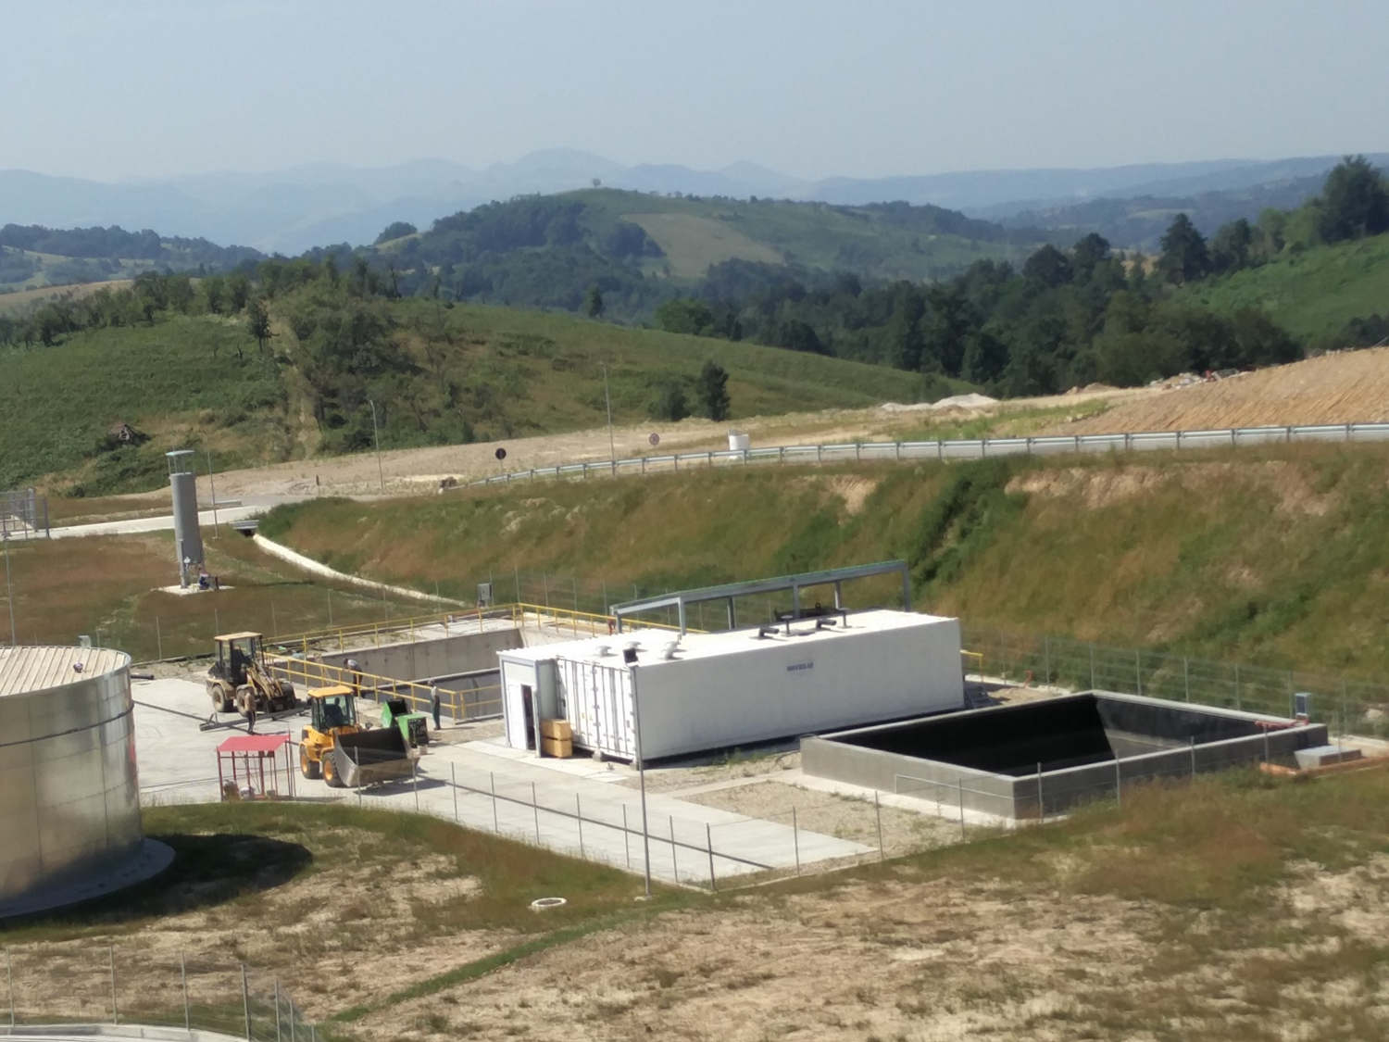
RCDT references
Galicia, Spain
600 m³/d leachate treatment
Triple stage RO, 2 x (84 + 27 + 18) RCDT Modules
2 x (1008 m² + 324 m² + 144) m² membrane area
Caras, Romania
170 m³/d leachate treatment
Triple stage RO, 60 + 15 RCDT modules + 6 spiral elements
720 m² + 180 m² + 204m² membrane area
REFERENCES for RO – Leachate water | III

Slide 15
Basics of biological wastewater Treatment
using a membrane bioreactor (MBR)
The carbon compounds are broken down into carbon dioxide CO₂ and water H₂O. The COD measures the amount of oxygen needed to chemically oxidize all organic compounds.
02
Phosphorus compounds: Similar to nitrogen, phosphorus is also essential for cell growth and is integrated into the cells during the growth of biomass.
MBR – membrane Bio-Reactor for water Treatment | IV
Nitrogen compounds are broken down in two steps.
  Nitrification: Ammonium (NH4-N) is biologically oxidized by oxygen to nitrate (NO3-N).
  Denitrification: the formed and already existing nitrate (NO3-N) is microbiologically reduced to atmospheric nitrogen (N2).
部分二
Sulfur, metals, trace elements, alkali and alkaline earth metals: the microorganisms also need defined minimum quantities of these substances so that they can maintain their life cycle.

Slide 16
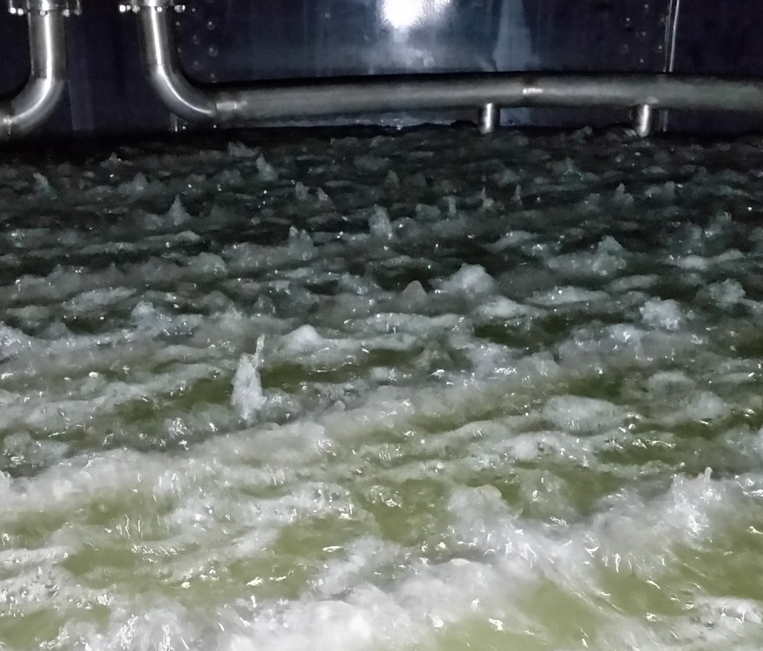

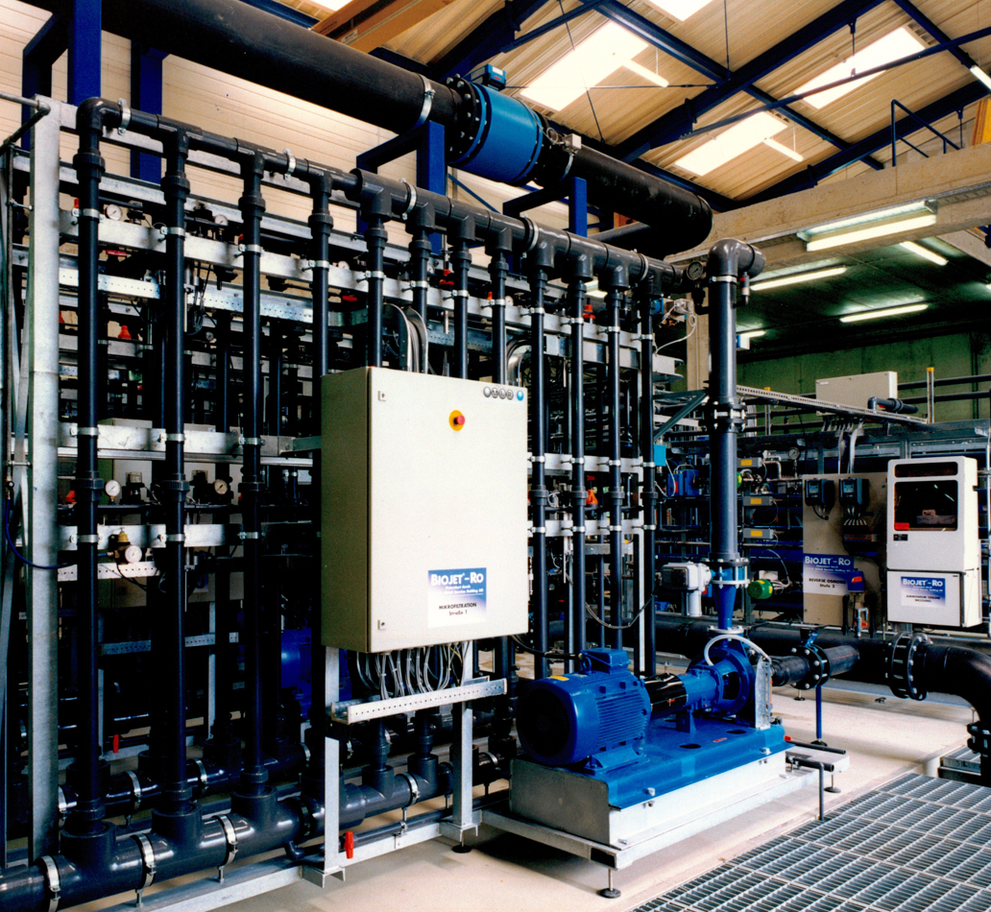
R&D cooperation
with EnviCare® Engineering GmbH
Active in membrane technology since 1996
Engineering consultant for
  Process and environmental technology
  Safety processes
  Environmental biotechnology
  Waste management
  Renewable energy:
  biogas / biomethane / hydrogen
Certified expert in Graz, Austria
  Wastewater treatment
  Waste management
  Landfilling and remediation
  Chemical process engineering
Introduction | I

Slide 17
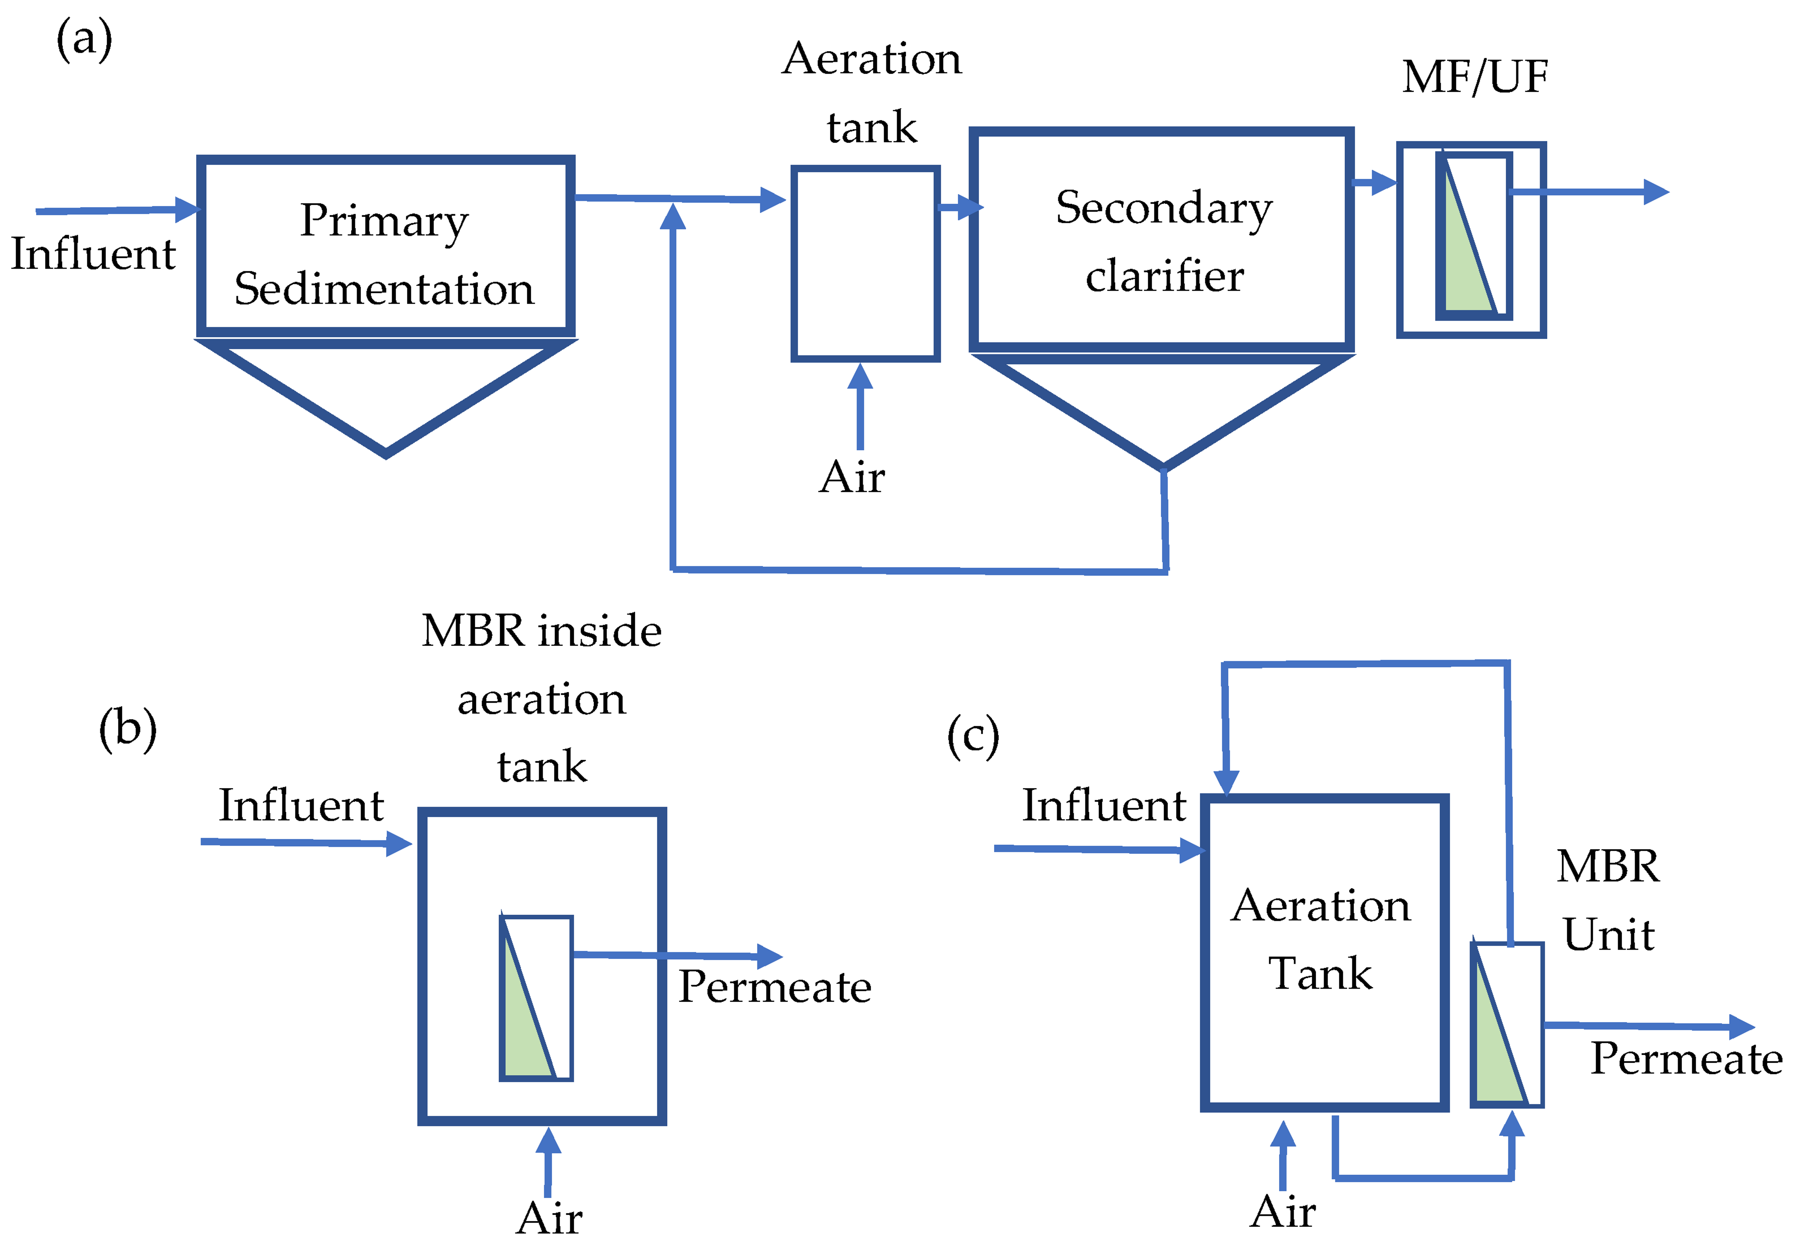
conventional process versus membrane bioreactor (MBR)
Conventional activated sludge process + tertiary filtration
submerged MBR
External/side-stream MBR
smaller reactor size
less generation of Waste Activated Sludge (WAS)
controled and longer Solid Retention Time (SRT)
higher effluent quality during treatment process due to the membrane
Notes:
https://www.mdpi.com/membranes/membranes-13-00181/article_deploy/html/images/membranes-13-00181-g003.png
Figure 3. (a) Conventional activated sludge process + tertiary filtration, (b) immersed MBR, (c) side-stream MBR.
Aus <https://www.mdpi.com/2077-0375/13/2/181>

Slide 18
Use Cases: MBR
CASE (Year): | Membrane Bio-Reactor for water treatment
Advantages / Specialties | New EU regulation requires the retrofitting of wastewater treatment plant Freely selectable sludge age Solid-free filtrate enables the Re-Use of filtrate germ-free, microplastic-free filtrates Reduced space requirements Flexible unit operation in process engineering Continuous development of membrane technology Decreasing costs for the membrane The MBR-Process can be adapted to various applications
Notes:
Oberflächenwasser – Nachfolgeprojekt, Pilotierung 2018/2019, IBN Großanlage August 2020
Kommunales Abwasser (Anpassung einer Teichkläranlage) - 2002
Im Teich CSB Reduktion auf 300 mg/l => Nitrifikation + restliche CSB-Entfernung in der MBR; seit 2002
Flüssige Abfälle (Nachreinigung nach Verdampfung und Flotation) – 2016
Flüssige Abfälle = Öl-Wasser-Gemische, Emulsionen => Verdampferdestillate, Ablauf aus Flotationsanlagen
90 m³/d
Indirekteinleitung
Deponiesickerwasser (Deponie A) – 1994
Deponie Pilotierung (Deponie B) - 2018
Deponie C Pilotierung (laufend)
Getränkeabfüllung (Anpassung einer SBR-Anlage) – 2018
180 m³ Volumen
60 m³/d
Tlw. > 10.000 mg CSB/l
Indirekteinleitung
Biodieselerzeugung - 2008

Slide 19
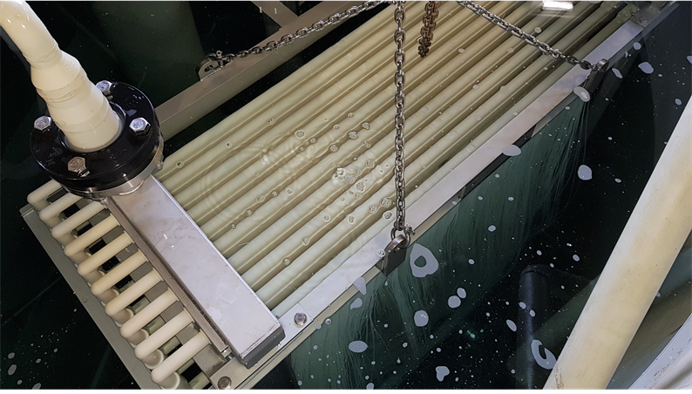
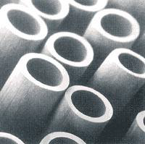
Hollow fibre membrane
The hollow fiber membranes are stretched between 2 permeate collection tubes with a defined excess length in order to allow them to oscillate in the rising mixture of air and biomass.
The aeration device below the membranes increases the turbulence and thus the scouring effect on the membrane surface. Backwashing with clean permeate is possible.
The transmembrane pressure of up to 0.4 bar controls the amount of filtration and is provided by a suction pump.
The membranes are made of PVDF and are permanently hydrophilic. The fibers are highly resistant to flex fatigue. The membranes can be stored dry and do not need to be pre-wetted before use. The individual fibers are assembled into flat "curtains". Several curtains are mounted in a steel frame, forming a module. The filtrate is drawn off via connection lines.
The membrane area of a technical module can be 200, 400, 800 or 1,200m².
MEMBRANE MODULE: 400 m² Material: Polyvinylidene fluoride (PVDF) 0.05 µm hollow fiber submerged

Slide 20


Hollow fiber membrane
Submerged Membrane Module, 400m²
The hollow fiber membranes are stretched between 2 permeate collection tubes with a defined excess length to allow them to oscillate in the rising mixture of air and biomass.
The aeration device below the membranes increases the turbulence and thus the scouring effect on the membrane surface. Backwashing with clean permeate is possible.
The transmembrane pressure of up to 0.4 bar controls the amount of filtration and is provided by a suction pump.
The membranes are made of PVDF and are permanently hydrophilic. The fibers are highly resistant to flex fatigue. The membranes can be stored dry and do not need to be pre-wetted before use. The individual fibers are assembled into flat "curtains". Several curtains are mounted in a steel frame, forming a module. The filtrate is drawn off via connection lines.
The membrane area of a technical module can be 200, 400, 800 or 1,200 m².

Slide 21
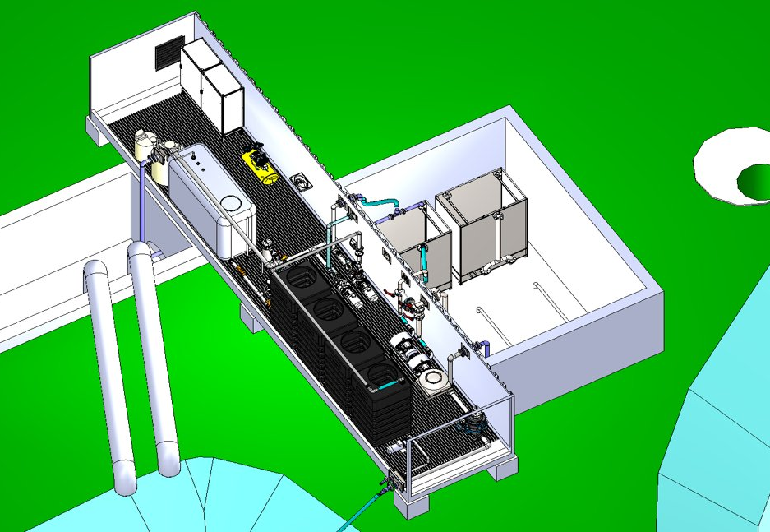
MBR for Contaminated surface water - 2019
Capacity:
380 m³/d
Membrane area: 800 m²
MBR – membrane Bio-Reactor for water Treatment | IV

Slide 22
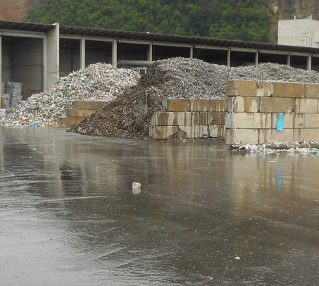
Surface water treatment on a waste management site
Wastewater origin:
  Collected contact water from outdoor waste heaps , rain run-off from dirty roads
  Contaminated with organic and inorganic substances
  Discharge of the rain induced wastewater into the public sewer is not allowed and would be problematic due to the hydraulic peak load!
  A treatment prior to direct discharge is necessary
Treatment goals – regulatory compliant according:
  Storage and treatment of the first heavy rainfall
  Storage volume for at least 15 minutes
Quality goal:
  direct discharge according to the national emission regulation.
Challenges:
  Strongly fluctuating quantities and qualities of surface water
  COD, N and P elimination
  Heavy rain events and long dry periods (up to 8 weeks!)
  Low inflow temperature in winter (< 5°C)
REFERENCES for MBR – water Treatment | IV
Notes:
according to Austrian water law

Slide 23
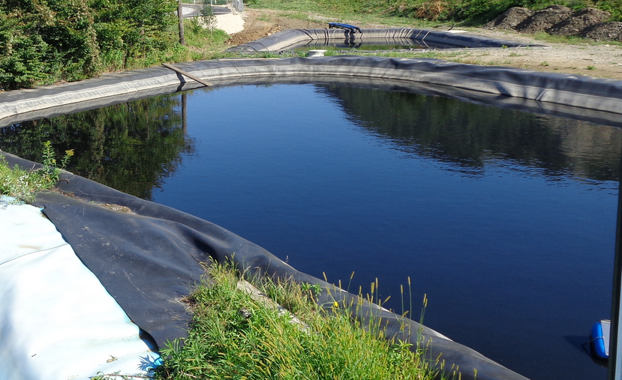
Task
Sedimentation
basin
Conditions on site
  Area: ~ 43,000 m²
  Surface water collection in two different areas (A and B)
  Various run-off coefficients
  Existing sedimentation basins
Surface water quality
  Limit values for direct discharge are exceeded
REFERENCES for MBR – water Treatment | IV
 | Area A |  | Area B |  | Limit Value
 | Range | Average | Range | Average
pH [-] | 6.5 – 8.3 | 7.3 | 6.4 – 7.7 | 7.0 | 6.5 – 8.5
Electr. Conductivity [µS/cm] | 288 – 2,080 | 929 | 340 – 2,700 | 1,013 | -
COD [mg/l] | 51 – 385 | 151 | 143 – 1,590 | 466 | 120
Filterable solids [mg/l] | 1.0 – 110 | 14.3 | 2.2 – 180 | 27.3 | 30

Slide 24
Use Case: MBR for surface water
CASE (Year): | Membrane Bio-Reactor for surface water treatment (2020)
Advantages / Specialties | New EU regulation foster the retrofitting of wastewater treatment plant Particularly suitable for the use of rainwater after heavy rainfall events MBR plants cost-effectively and cost-efficiently during construction and operation Service life of MBR systems > 5 years Space-saving: The space requirement 50% compared to conventional systems Freely selectable sludge age → High degrees of elimination (COD, N, P) MBR filtrate is solids-free and biologically inactive Excellent effluent quality, water can be reused immediately Enables direct discharge into receiving waters and reuse as process water Reduces freshwater consumption, wastewater volume, chemical and energy consumption and protects the environment

Slide 25
Technical Installation - Results
Compliance with all limit values since commissioning in July 2019
No problems with
  algae and foam formation
  Nutritional supply
Winter operation
  No feed for 47 days
  Temperature of the biology down to 4.5 °C
  Compliance with all limit values at the first measurement after restarting
Summer
  Several heavy rain events > 300 m³/d
  No impairments in biology or membrane
REFERENCES for MBR – water Treatment | IV
Notes:
CSB Grenzwert wird seit IBN eingehalten
Auch alle anderen vorgeschriebenen Grenzwerte (Kohlenwasserstoffe, Tenside, lipophile Stoffe) werden ausreichend gut eliminiert
Keine Probleme mit Schaum => Sprühsystem ausreichend
Keine Probleme mit Algen => Durchmischung im Speicherbecken gut
Nährstoffversorgung wie auch bei Pilotanlage ausreichend
Winterbetrieb
47 Tage ohne Zulauf, aber Belüftung weiterhin eingeschalten
Geringfügige Reduktion des Biomassegehaltes in diesem Zeitraum
Minimale Gemessene Temperatur im Biologiebecken 4,5 °C
Nach Wiederinbetriebnahme: Probe auch durch externes Labor => alle Grenzwerte eingehalten
Sommer 2020
Mehrere Starkregenereignisse
Keine Beeinträchtigungen

Slide 26
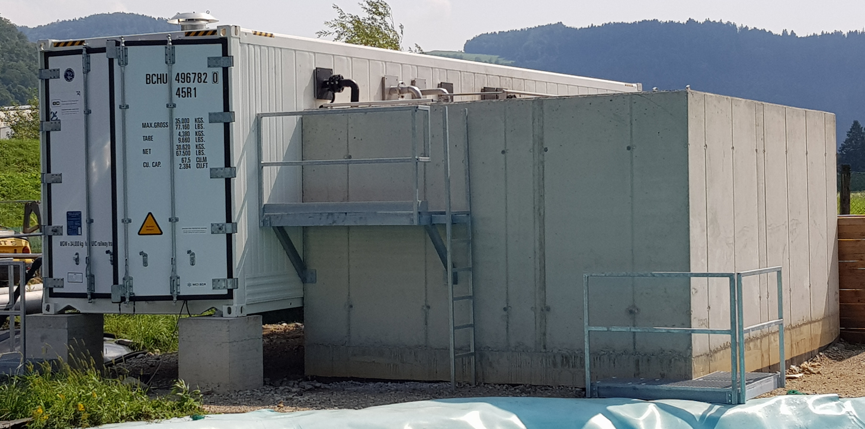
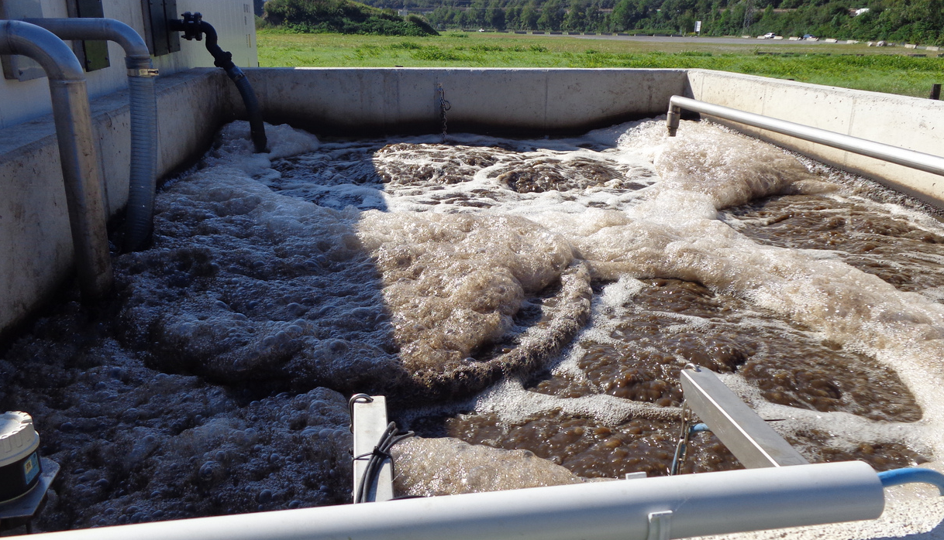
Technical Installation
Start-up in July 2019
Regulatory compliant
Quick outline
  40' operating container
  Membrane module 800 m²
  Membrane type: hollow fibre (submerse)
  Membrane material: PVDF
  Cut off: 50 nm
  MBR-volume 80 m³
  Aeration: 190 Nm³/h
  Water throughput < 16 m³/h
Storage basin is emptied < 48 h
  Throughput = f(storage level)
REFERENCES for MBR – water Treatment | IV
MBR Technical Installation
Aerated basin
Notes:
Pumps, ventilation, controll system, PLS all in a 40‘‘ operating container
Adjacent a concrete biology basin with aeration and membrane module and recirculation pump and spraying nozzle
Goal: emptying of the sedimentation basin in under 45 hours which leads to a necessary throughput of 380 m³/d or 16 m³/h
The filtration capacity is depending on the level in the sedimentation basin

Slide 27
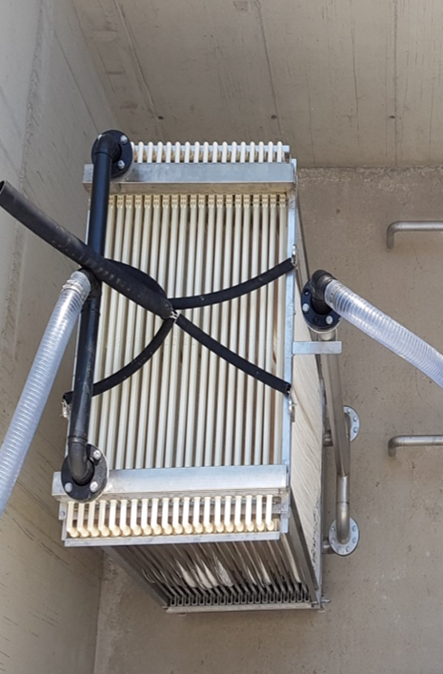
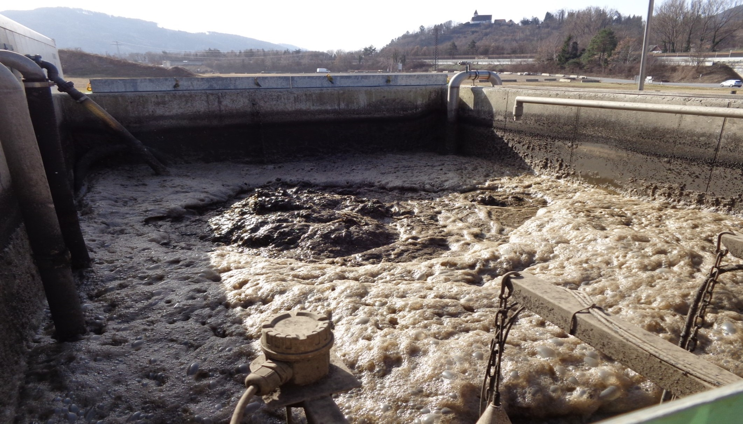
Membrane module in the bioreactor basin before filling
MBR – water Treatment | IV
Membrane bioreactor basin in function

Slide 28
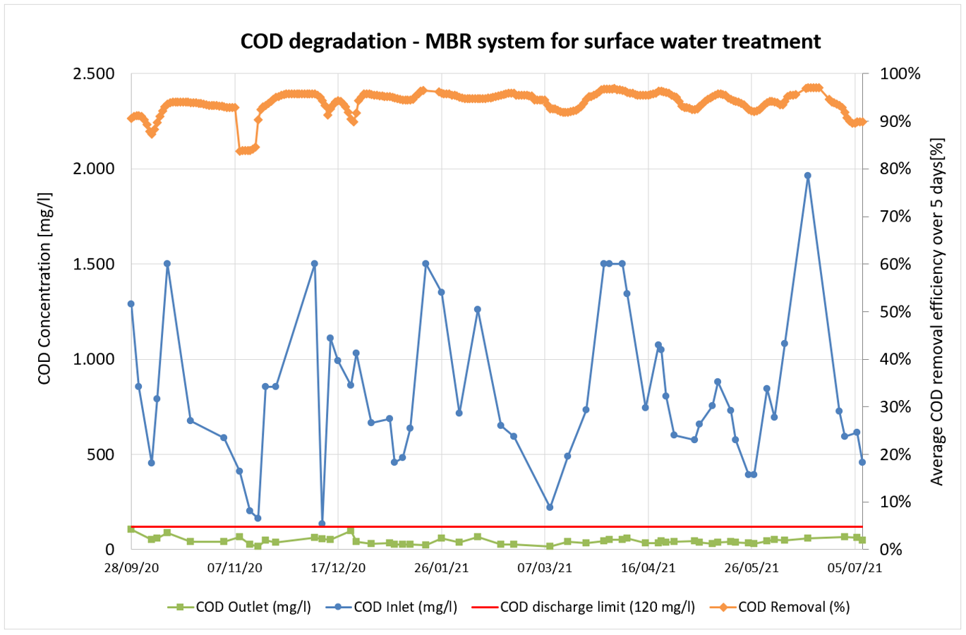
COD degradation - MBR system for surface water treatment
MBR – water Treatment | IV
Notes:
COD outlet was safely under the removal limit threshold
COD degradation was constantly over 90 %

Slide 29
Use Case: MBR for liquid wastes
CASE (Year): | Membrane Bio-Reactor plant for liquid waste treatment (2020)
Advantages / Specialties | MBR plants cost-effectively and cost-efficiently during construction and operation Service life of MBR systems > 10 years Space-saving: The space requirement 50% compared to conventional systems Freely selectable sludge age → high degrees of elimination (COD, N, P) MBR filtrate is solids-free and biologically inactive Excellent effluent quality, water can be reused immediately Enables direct discharge into receiving waters and reuse as process water Reduces freshwater consumption, wastewater volume, chemical and energy consumption and protects the environment

Slide 30
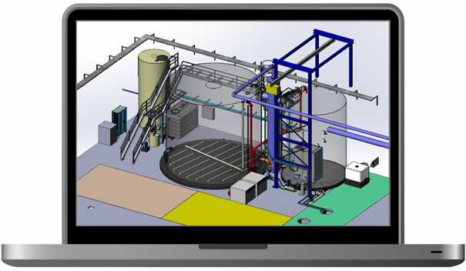
MBR Treatment of liquid waste - 2021
Capacity:
250 m³/d
Membrane area:
1.600 m²
MBR – water Treatment | IV

Slide 31
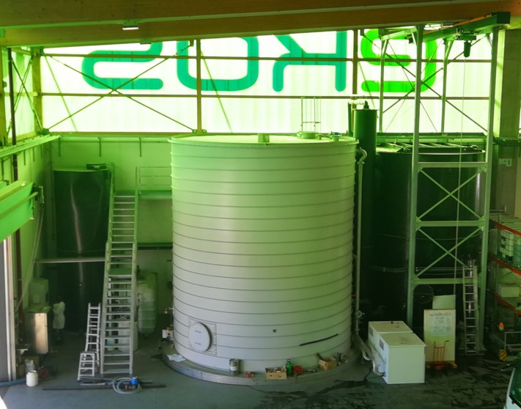
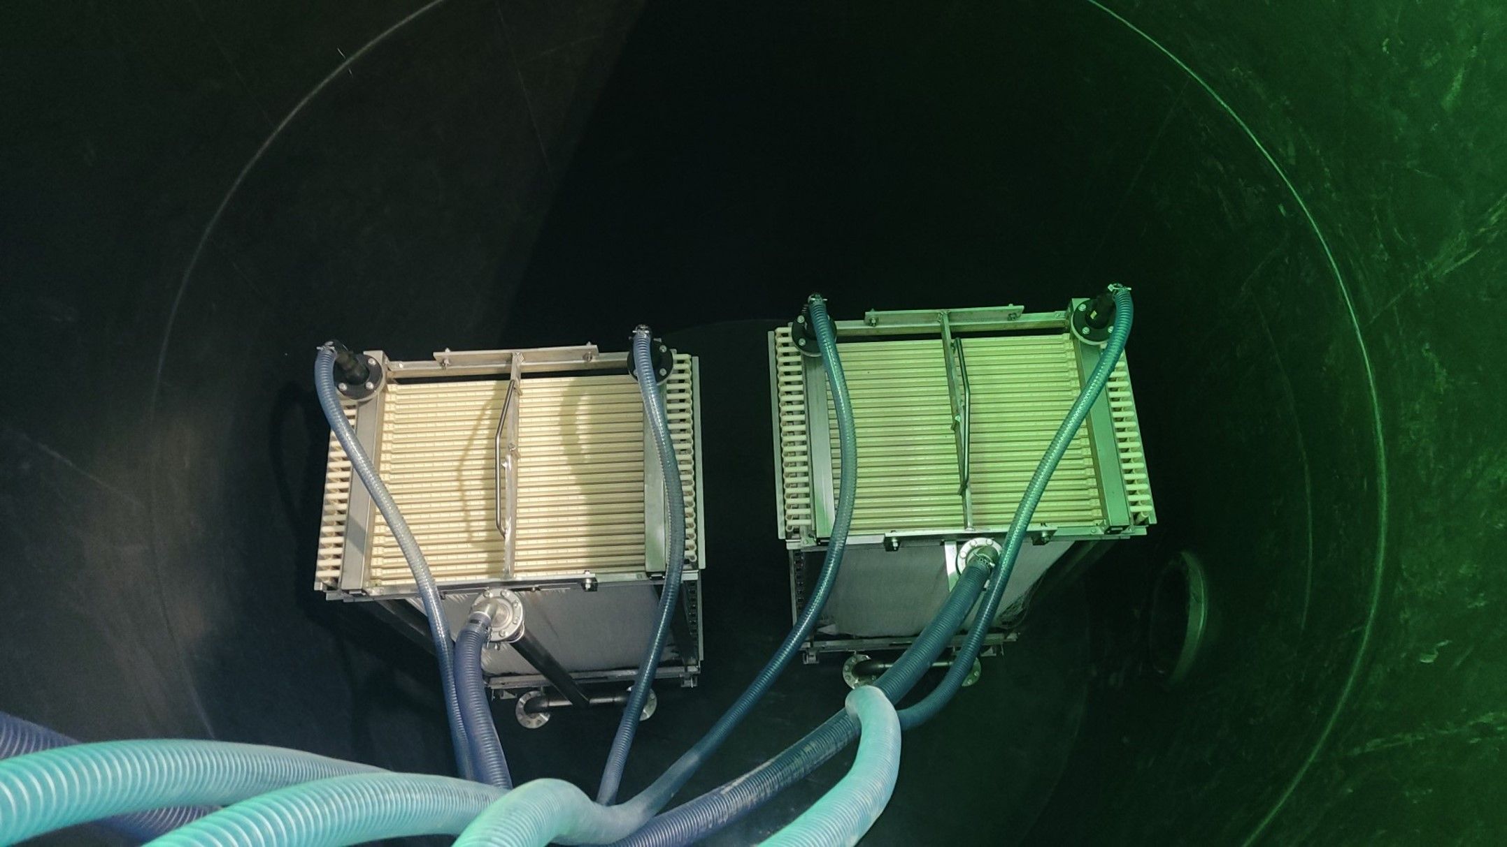
Permeate tank, bioreactor tank, membrane tank
Membrane modules in the membrane tank before filling ,2 x 800 m² membrane area
MBR – water Treatment | IV

Slide 32
Use Case: MBR for softdrink production
CASE (Year): | Membrane Bio-Reactor plant for wastewater from softdrink production
Advantages / Specialties | MBR plants replaces conventional SBR plant cost-effectively and cost-efficiently during construction and operation Space-saving: The space requirement 50% compared to conventional systems Freely selectable sludge age → high degrees of elimination (COD, N, P) MBR filtrate is solids-free and biologically inactive Excellent effluent quality, water can be reused immediately allows direct discharge into receiving waters and reuse as process water Comply with EU water quality directive Reduces chemical and energy consumption and protects the environment

Slide 33
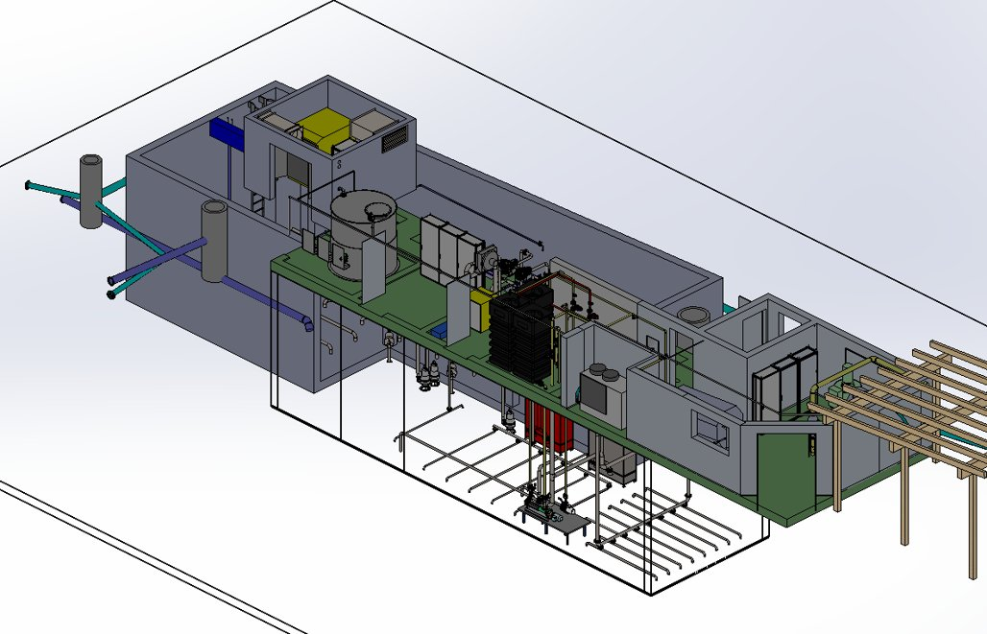
Soft drink production
Capacity 60 m³/d, Membrane area 400 m², 2019
Extension to 90 m³/d Membrane area 800 m², 2020
MBR – water Treatment | IV

Slide 34
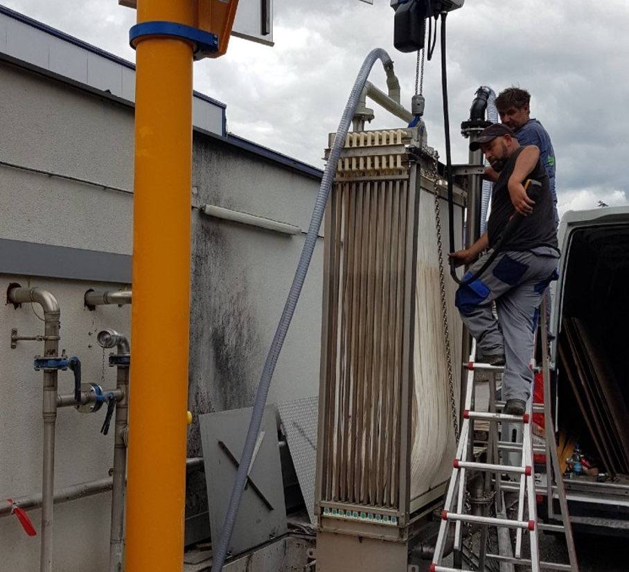
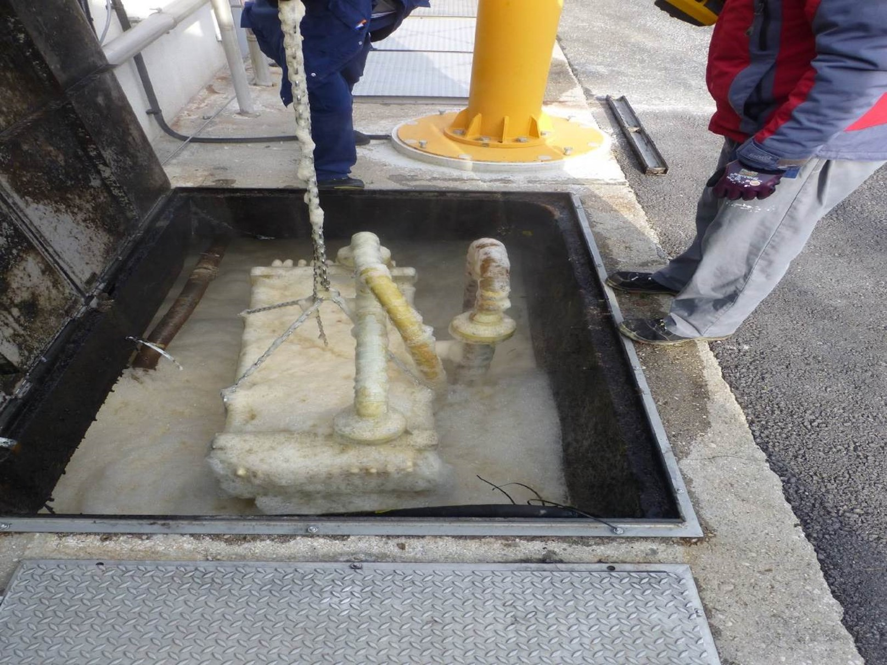
Membrane module before external cleaning
MBR – water Treatment | IV
Membrane module during external cleaning

Slide 35
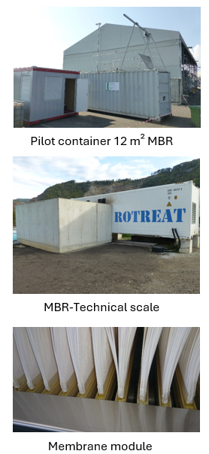
Conclusion
On site pilot-testing makes sense!
  Learn fluctuating wastewater quality & quantity
  Reduce risk
Proof of concept
  Stable COD degradation
  Sludge yield: 0.44 kg TS/kg COD
  Absorption and degradation of hydrocarbons and lipophilic substances
  Adsorption of metals in activated sludge
  Retention of filterable substances (inorganics - metals) at the membrane
  Adequate nutritional supply
Membrane is suitable
  Stable permeability
  Regular cleaning is necessary
Lessons learned
  Conservative approach (biovolume,
  membrane area) improves flexibility and durability
  Filtrate can be reused as process water
MBR – water Treatment | IV
Notes:
Sinnhaftigkeit der Pilotierung
Vor allem in der Industrie kann die Abwassermenge und –zusammensetzung betriebsbedingt stark schwanken und auch die Inhaltsstoffe sind sehr betriebsspezifisch. Die Durchführung eines Pilotversuches bietet dabei erhebliche Vorteile, um das Abwasser, die Betriebsbedingungen, aber auch die oft entscheidende menschliche Komponente in der Betriebsführung kennen zu lernen. Bei der in diesem Beitrag vorgestellten Anlage konnte mit der Pilotierung die grundsätzliche Eignung des Prozesses festgestellt und dadurch auch das technische und unternehmerische Risiko für Planer, Lieferant und Auftraggeber minimiert werden.

Slide 36

Technical Realisation
Container, or in house installation
Depending on the capacity and wastewater characteristics all machinery, e.g. control cabinet, blower, cleaning and backwash system, filtrate pump, filtrate storage tank can find place in an insulated and heatable 40`container.
Nitrification - Denitrification basin
The basins are located next to the machinery container, from where the necessary connections for aeration, filtrate extraction and wastewater feed goes to the membrane module and to the basin aeration pipes.
MBR – membrane Bio-Reactor for water Treatment | IV
Control System
The MBR unit is equipped with an industrial panel PC in the control cabinet door as interface, visualisation, data storage and remote-control device. All operating parameters, such as permeate flow, level settings, cleaning and backwash time interval can be easily set via touch screen. The unit is controlled by a PLC e.g. Siemens Simatic ET 200SP or equivalent.
Pretreatment, Prefiltration
The feed of the MBR system is carried out by a level controlled submergible pump.
It should be protected with a screen not bigger as 8 mm and mounted on a floater to protect the pump from sucking sediment from the bottom of the basin.
This pump transfers the wastewater to the machinery container, where it has to pass an automated backwash filter with a removal rate not higher than 500 µm (metal edge or sieve type).
This screen is necessary to protect the membranes against fibres and particles.

Slide 37
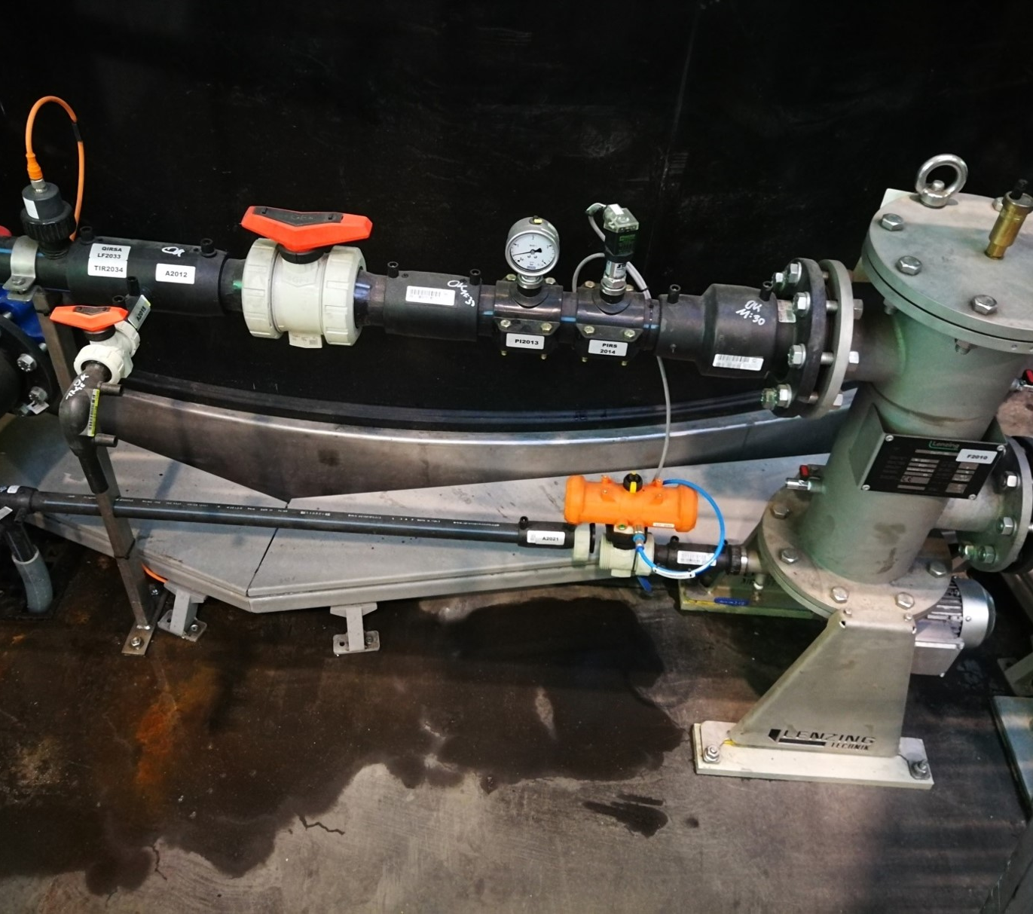
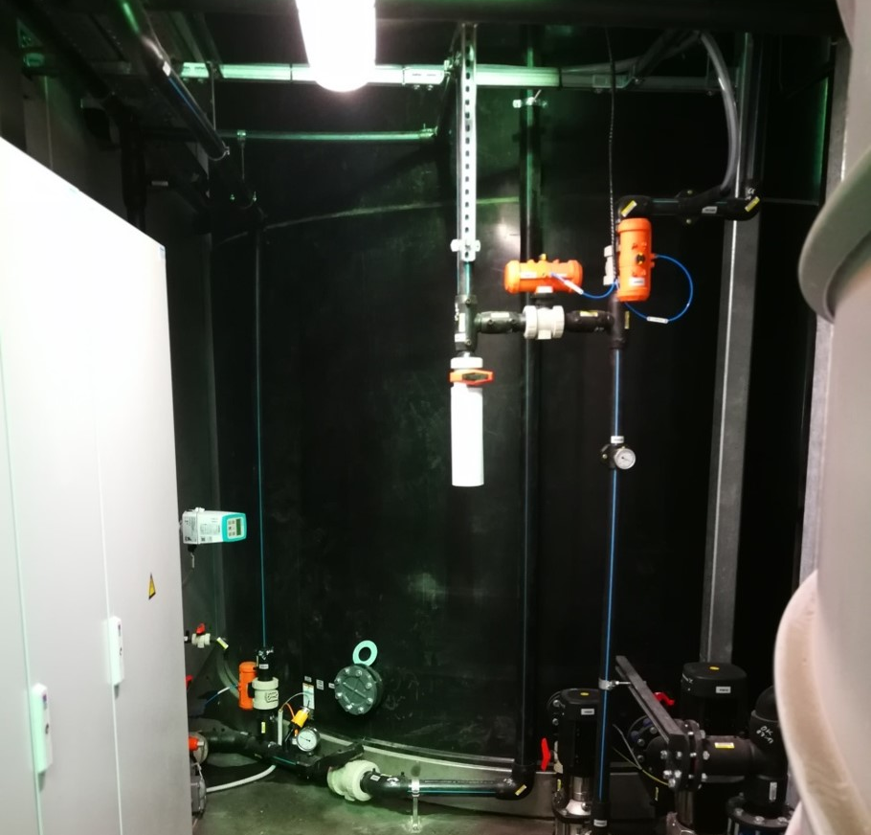
Membrane tank
Pre-Filtration line

Slide 38

Membrane bioreactor
By means of a truck crane the membrane module can be elevated directly into the nitrification basin.
A pressure transmitter measures the water level and gives command to the feed pump and to the filtrate suction pump. A level switch as additional safety against overfilling is installed.
Filtration
The extraction of the permeate is carried out by a frequency controlled, self-priming centrifugal pump, which provides the necessary negative pressure on the filtrate side. A flow measurement (IDM) for control of the extraction pump and the registration of the total cleaned water are situated before the inlet to the filtrate tank. Filtrate samples can also be drawn in this area.
The suction pressure is measured by a pressure transmitter and protects the membranes against too low or too high pressure.
MBR – membrane Bio-Reactor for water Treatment | IV
Aeration system
The aeration through the pipes below the membrane module feeds the biology with oxygen on one hand and on the other hand it prevents the membranes from fouling.
The air stream to the membrane module is be indicated and controlled by a flow switch.
A second air stream might be distributed to the nitrification basin by means of a stainless stell pipe-aeration system.

Slide 39
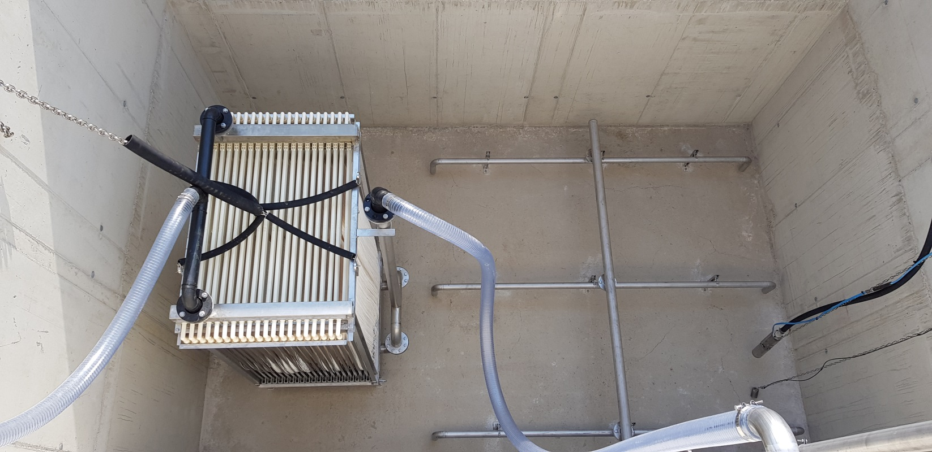
Membrane module in the bioreactor basin before filling

Slide 40

Membrane modules in the membrane tank before filling
2 x 800m² membrane area

Slide 41

Backwashing and Cleaning
As a precaution the membranes are cleaned by soft chemical cleaning periodically. Therefore, an alkaline/ acidic cleaning solvent and filtrate are pumped converse to the usual operation mode (backwashing).
The filtrate is be stored in a tank or communicating tanks before it leaves the container by overflow from these tanks.
The backwash pump (circular) takes water from the filtrate tank. The membranes must be protected from particles during backwash by means of a bag or cartridge filter with a removal rate of <50 µm.
As cleaning agents are used:
NaOCl – can be stored in transport cans on a safety containment and will be dosed inline to the backwash stream.
Citric acid – a sufficient tank with mixer for preparing the adequate cleaning solution with citric acid monohydrate and a pump for dosing inline to the backwash stream will be installed.
The backwash flow must be adjustable and is indicated.
For purposes of extern cleaning processes or maintenance the modules can be lifted out of the basin by truck crane, or a fix installed crane.
MBR – membrane Bio-Reactor for water Treatment | IV
Anti foam device
High organic wastewater can generate massive foaming when it is aerated. To protect the nitrification basin from foaming, a submergible circulation pump with spray-nozzle above the water surface can be installed. It is activated automatically, by a foam detection sensor.

Slide 42
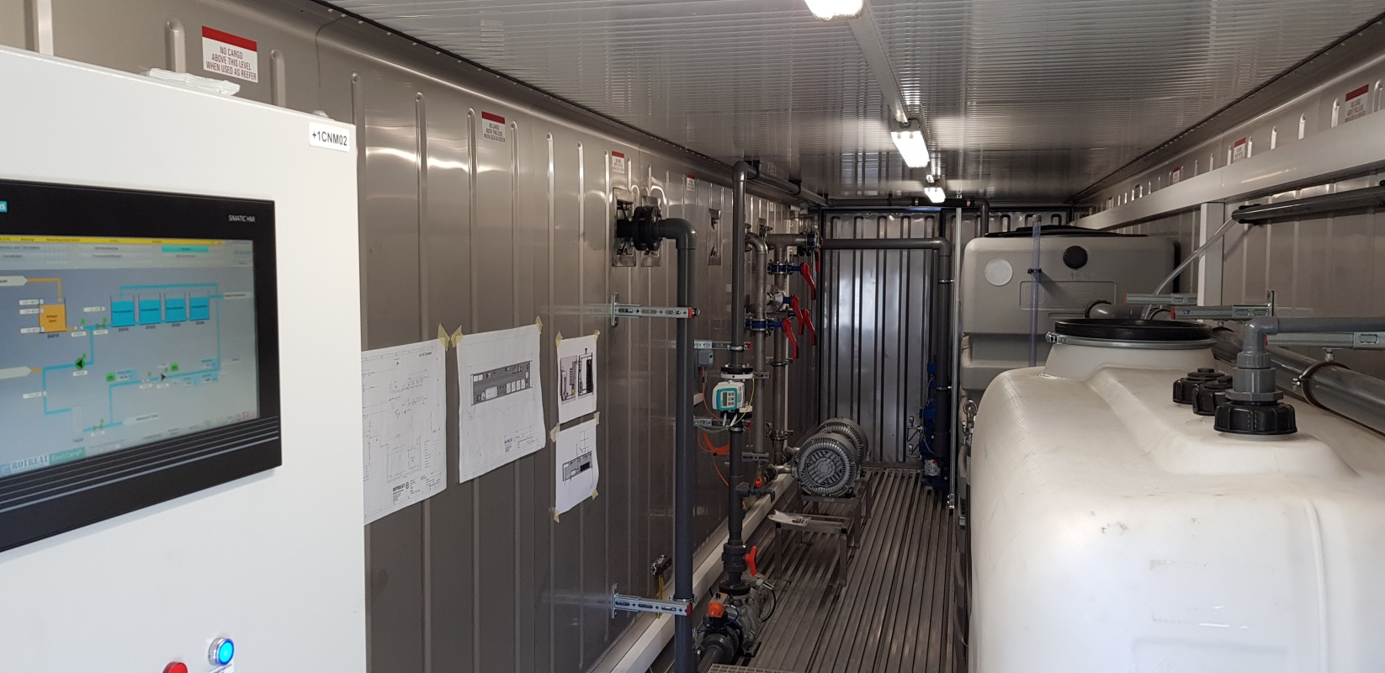
Containerized System inside

Slide 43
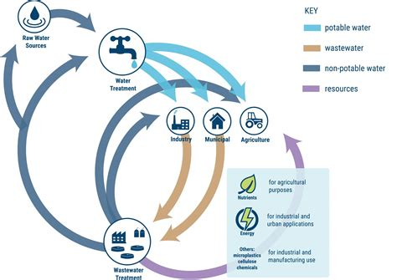
Water management and Circular Economy
We think, that water management in a circular economy is only affordable by smart (and digital) technologies, intelligent membrane separation processes, and a higher public awareness about the true value of potable water

Slide 44
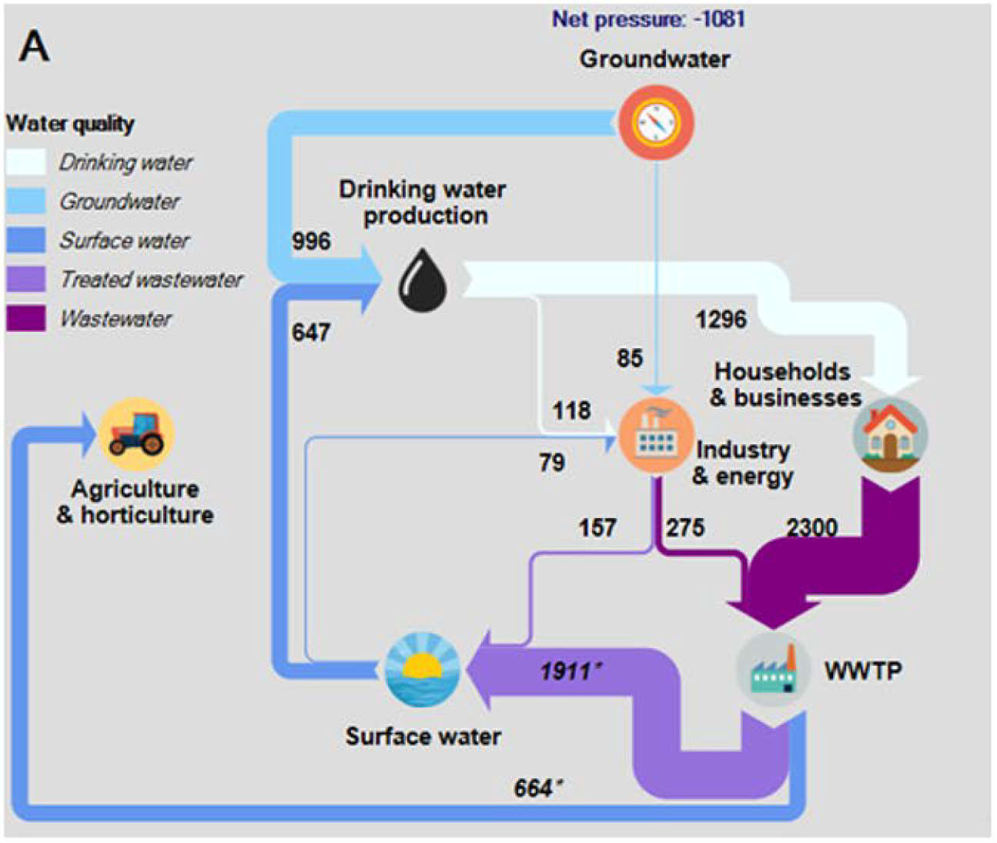
Water reuse scenario (NL)
Scenario: Water system of the Netherlands excluding cooling water:
Reuse of WWTP-effluent for irrigation , reuse of industrial effluent for irrigation
Notes:
Fig. 2 Water system of the Netherlands excluding cooling water for four different water reuse scenarios:
Reuse of WWTP-effluent for irrigation A, reuse of industrial effluent for irrigation B, reuse of WWTP-effluent for industry C, reuse of WWTP-effluent for groundwater replenishment D. The flows and the net pressure on the groundwater system are given in million m3 year−1. The sources and assumptions are given in the main text and in SI 1 and are here omitted for readability. Flows affected by the water reuse are given in italics and marked with an asterisk
Increasing Water System Robustness in the Netherlands:
Potential of Cross‑Sectoral Water Reuse
G. J. Pronk1 · S. F. Stofberg1 · T. C. G. W. Van Dooren1 · M. M. L. Dingemans1,2 ·
J. Frijns1 · N. E. Koeman‑Stein1 · P. W. M. H. Smeets1 · R. P. Bartholomeus1,3
Received: 24 March 2021 / Accepted: 20 July 2021
© The Author(s) 2021 https://doi.org/10.1007/s11269-021-02912-5

Slide 45
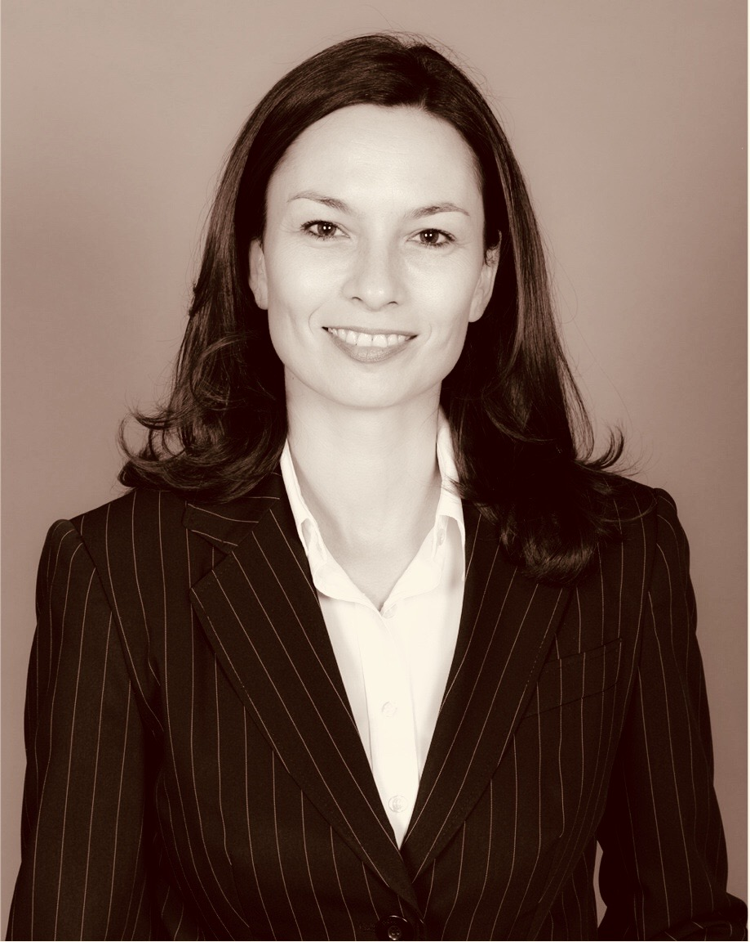
THANKS
Further information:
Janette Santon
Key account manager
janette.santon@rotreat.net
THE END

